Slide 1

AI Hype Discourse
Camille, Chaewon, Franziska

Slide 2
Our Goal
SLEEP 🛌🏻
SURVIVE 🍀
WAIT FOR CAKE 🍰
FANCY GRAPHS 📊

Slide 3
Overview of Data Sources
Source (2022-07-01 - 2023-07-10) | Amount | Articles that mention "#artificialintelligence| Artificial Intelligence| artificial intelligence|AI" | Word count (with / without stopwords) | Average words per document (with / without stopwords)
Facebook | 200296 posts | 30586 posts | 2803209 / 1777620 | 91.65 / 60
FOX News | 827 articles | 519 articles | 483151 / 280298 | 931/ 540
The Guardian | 600 articles | 425 articles | 354218 / 198754 | 834 / 474
New York Times | 704 articles | 704 articles | 1041505 / 606557 | 1479 / 862

Slide 4
Descriptive Statistics

Slide 5
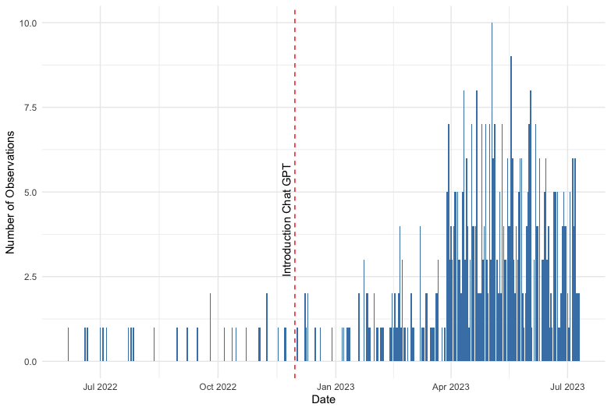
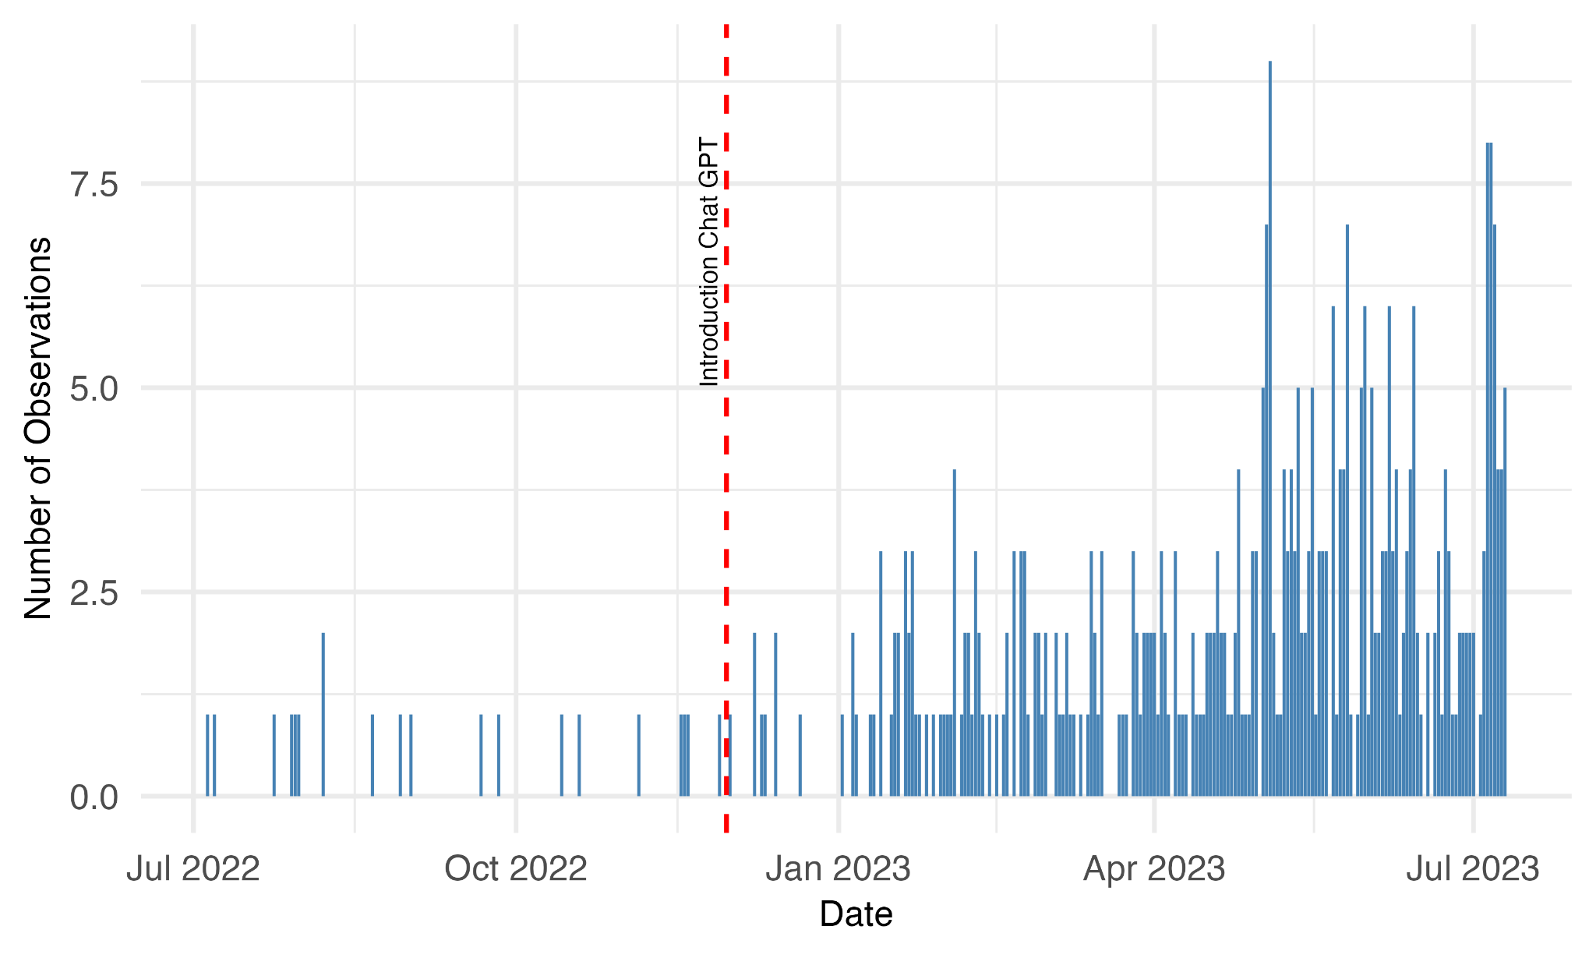
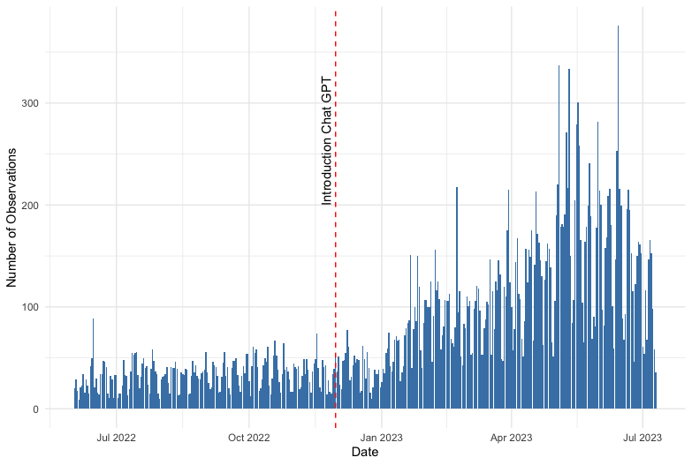
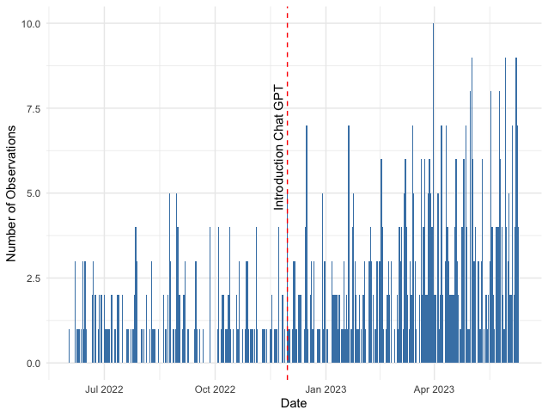
FOX
GUARDIAN
FB
NYT

Slide 6
Results:
Sentiment (Polarity)

Slide 7
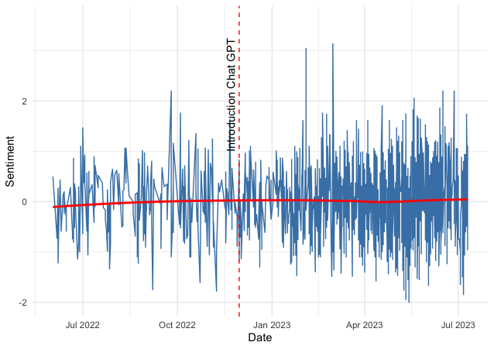
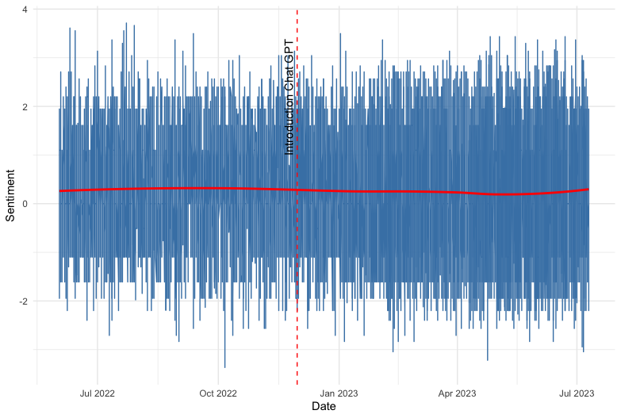
News Media vs. Social Media
NYT + Guardian + FOX
Facebook

Slide 8
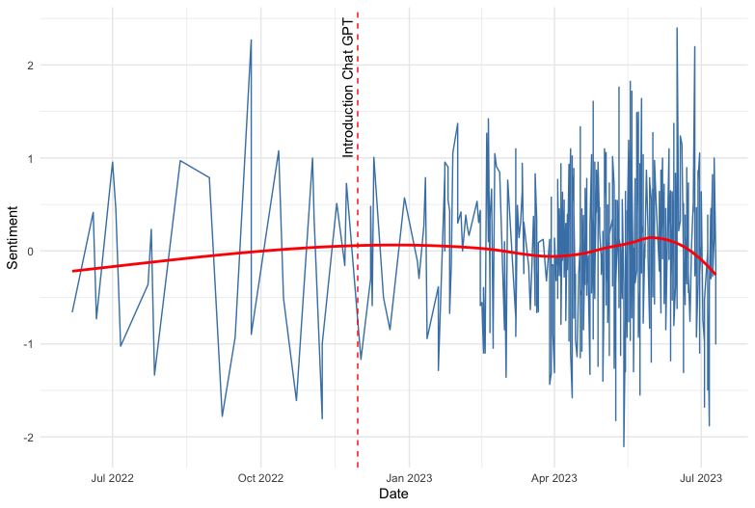
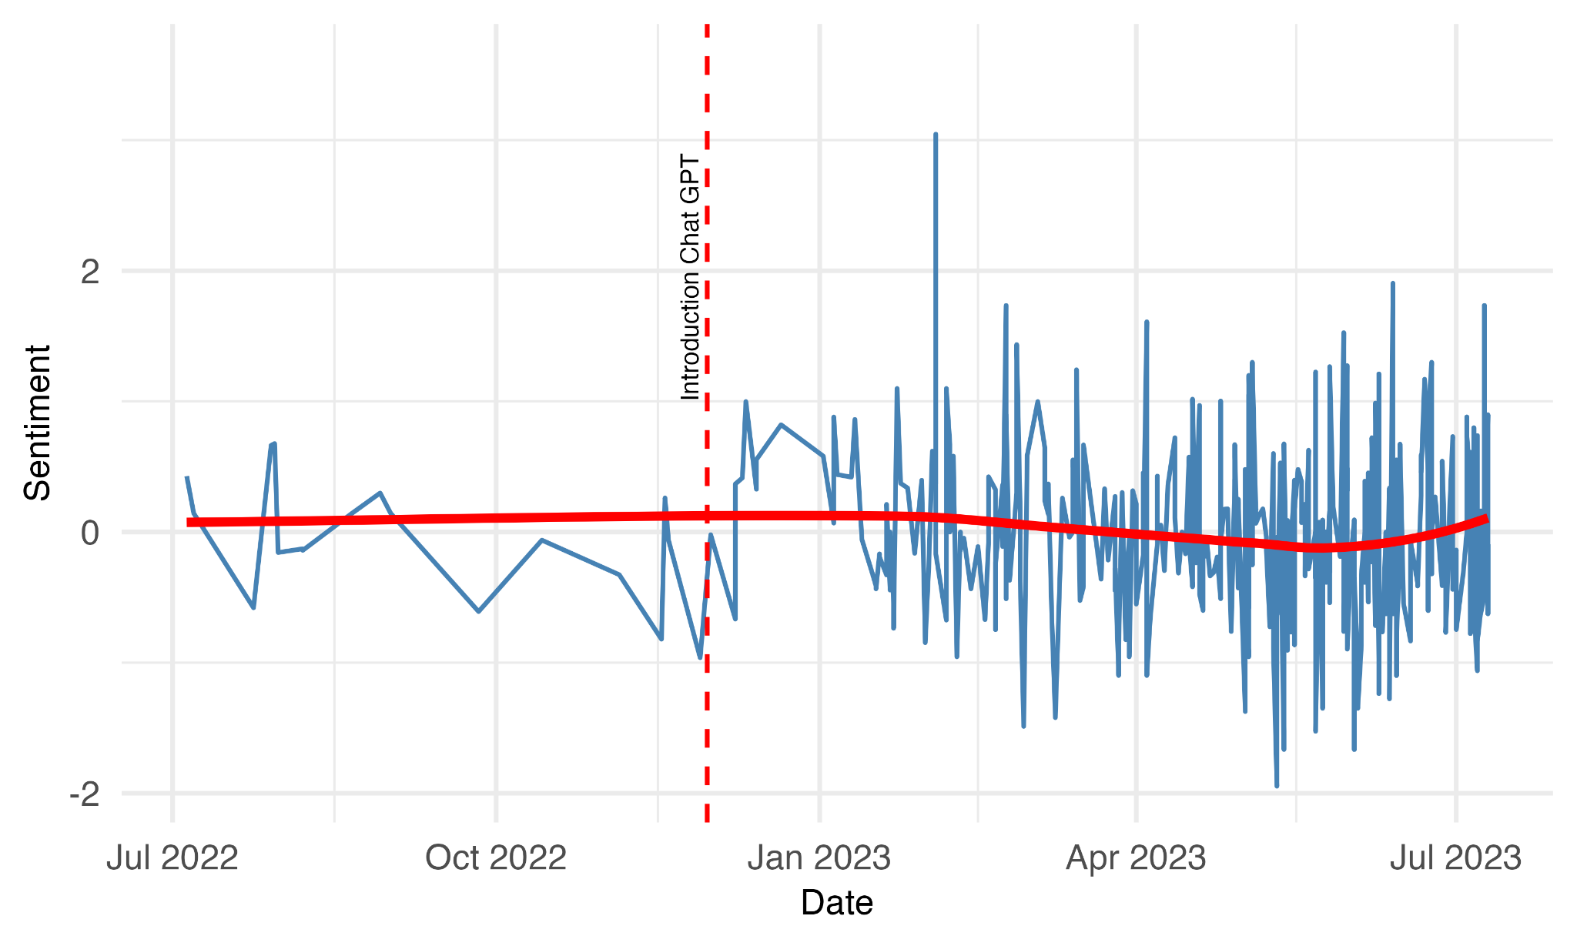
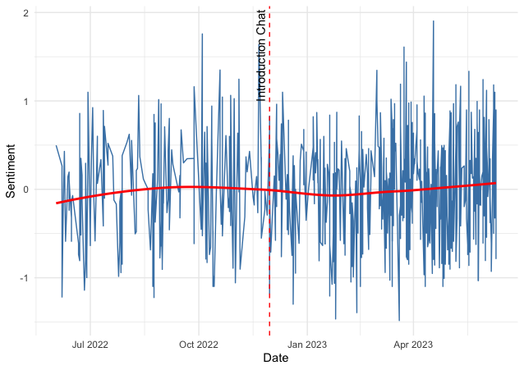
Different Newspapers
FOX
GUARDIAN
NYT

Slide 9
Analysis
Topic Models & Chi-squared feature detection

Slide 10
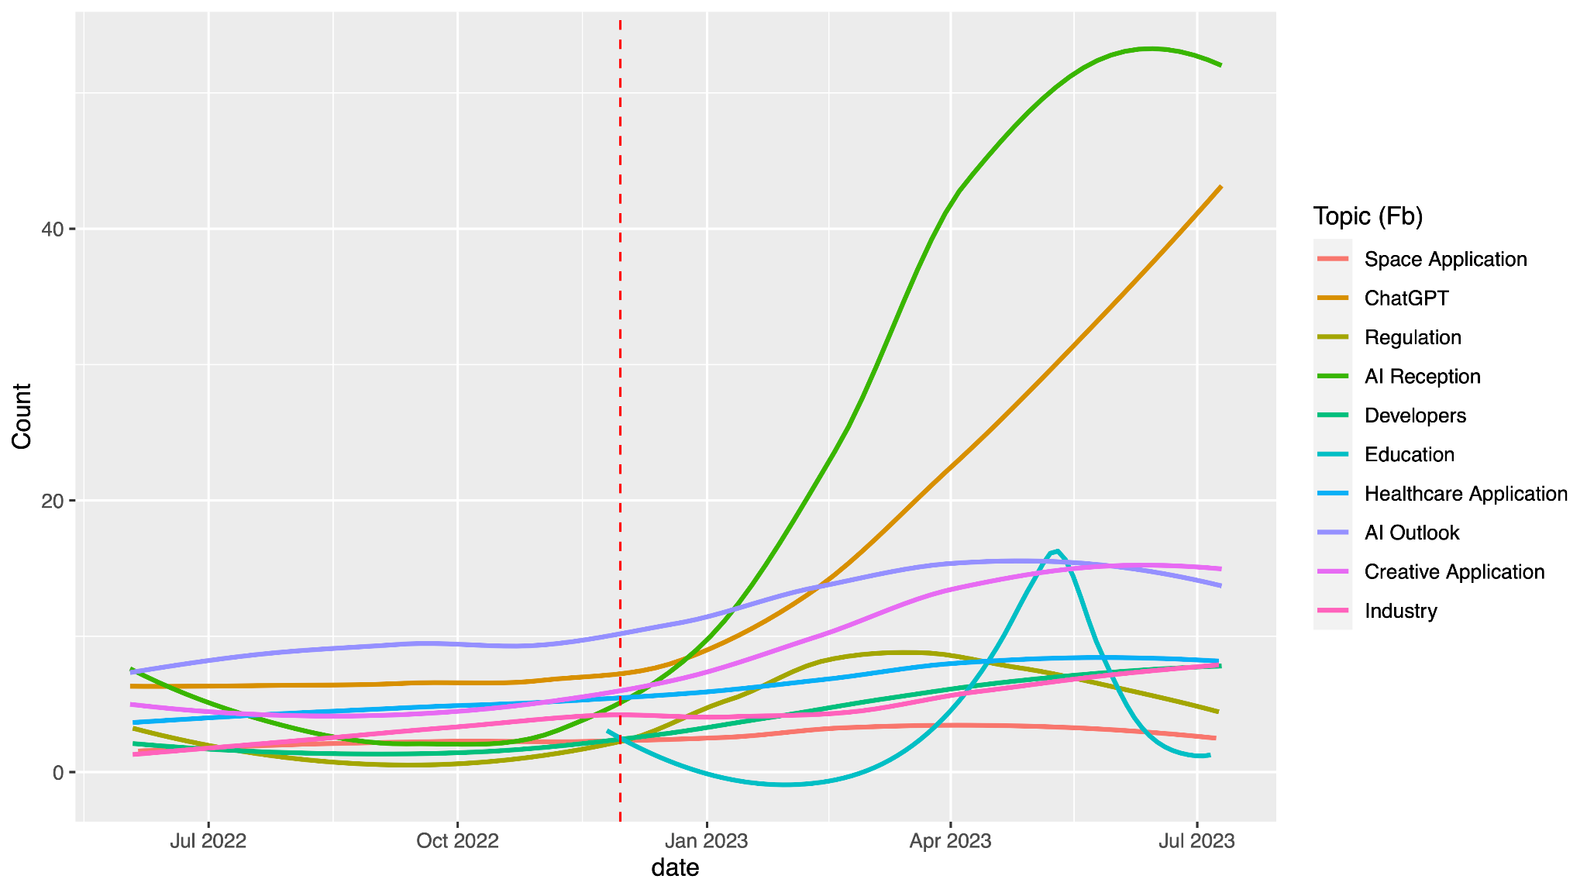
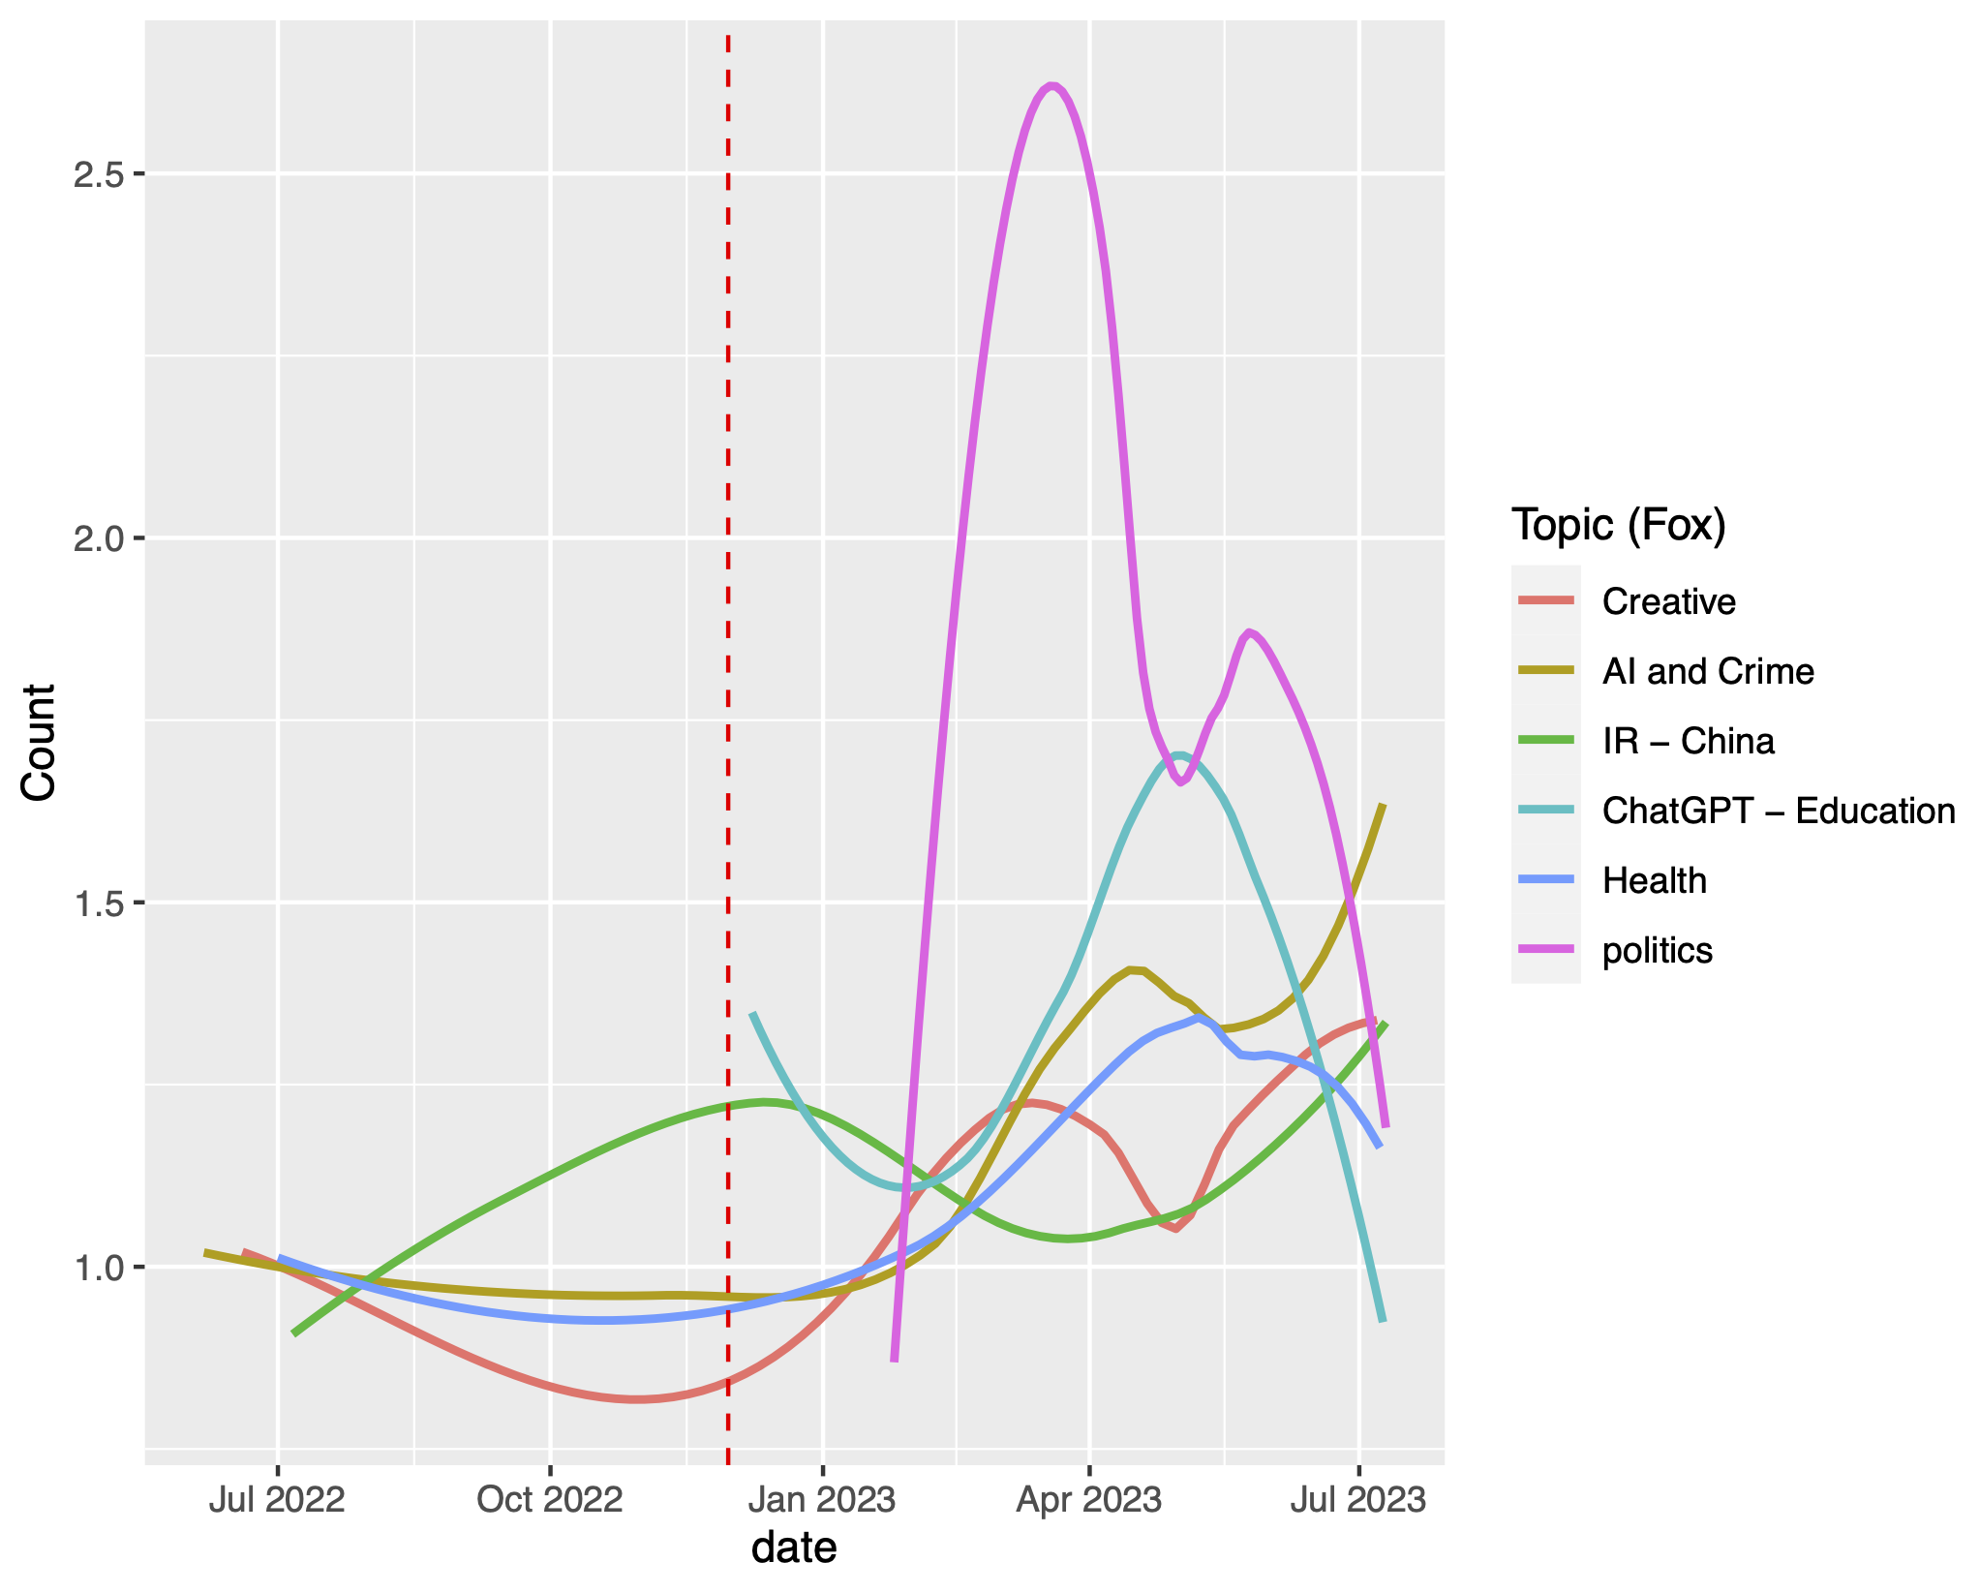
Facebook
Fox News

Slide 11
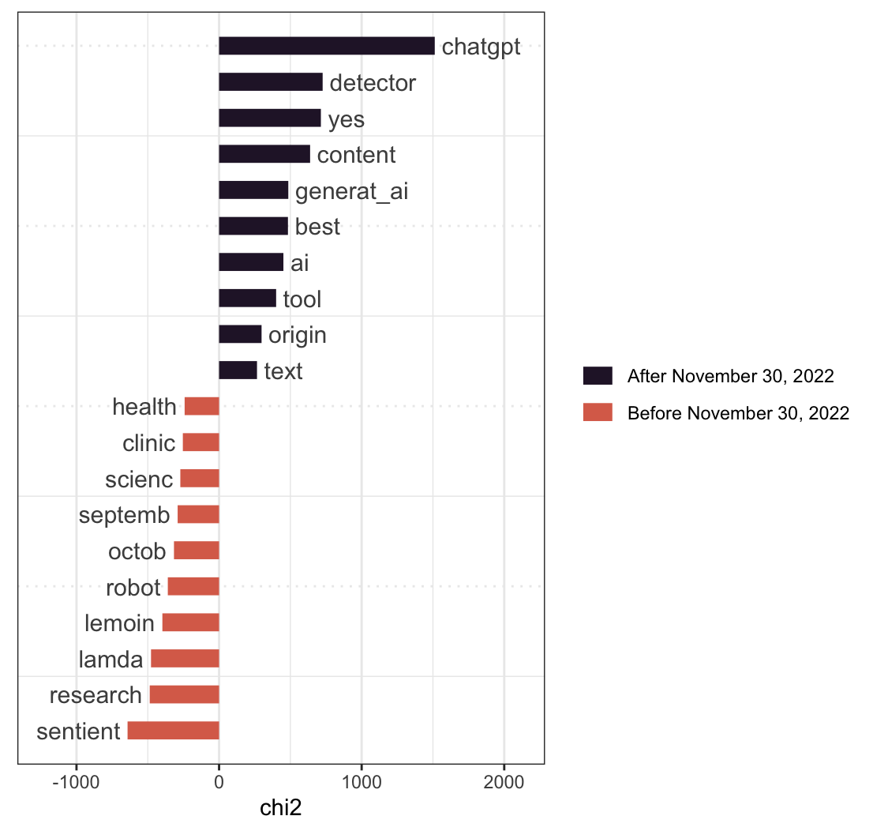
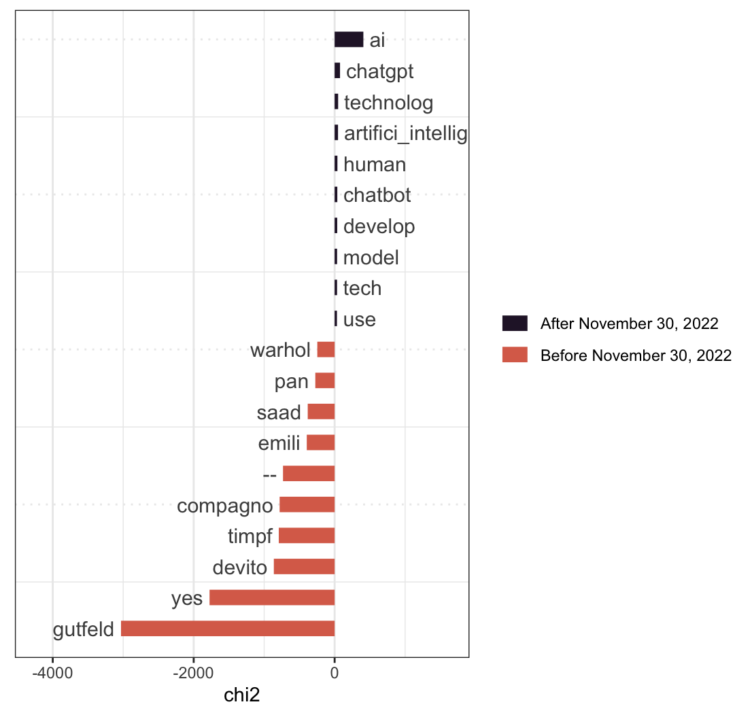
FB
FOX

Slide 12
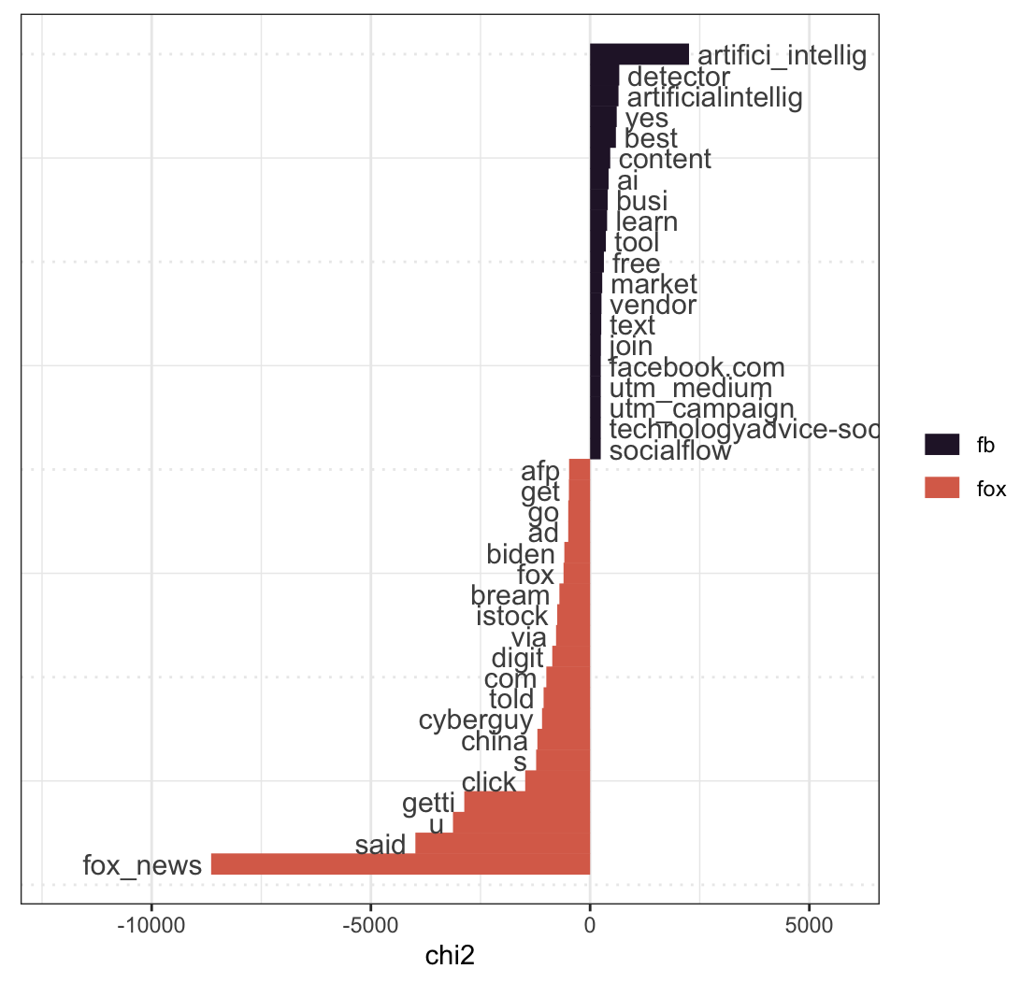

Slide 13
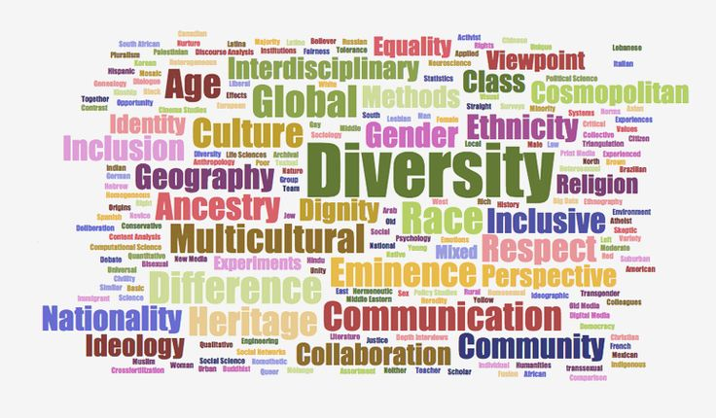
Sonia Giebel

Slide 14
Research Questions
What does diversity discourse look like in elite German universities?
  “Excellence initiative” universities: 10 universities + Berlin university consortium
  Investment to make German universities more competitive in the global higher education market (i.e. increase their rankings)
How does German diversity discourse compare to diversity discourse in the United Kingdom?
  Organizational theorists would predict that German universities would look to more highly ranked counterparts

Slide 15
Data & Methods
Manually collected urls of websites mentioning diversity or equality from the German excellence universities and analogous websites for Cambridge, Oxford, and London School of Economics
Web scraped text from these URLs
Bag of words approach
  Compare most frequently used terms
  Most key terms for each data set
  Created feature co-occurrence matrices (FCM) for both to visualize structure of diversity discourse

Slide 16
Comparing Frequent Words
UK |  | Germany
Token | Rank | Token | Rank
equal | 1 | univers | 1
univers | 2 | divers | 2
diverse | 3 | equal | 3
staff | 4 | research | 4
race | 5 | opportun | 5
fund | 6 | gender | …10
harass | …10 | devel | 11
gender | …12 | gender_equal | …15
charter | 13 | famil | …20
award | 14 | women | …25
inclus | 15 | science | 26

Slide 17
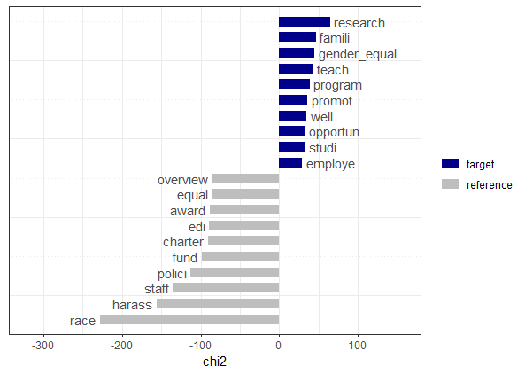
Germany
UK
Comparing key terms

Slide 18
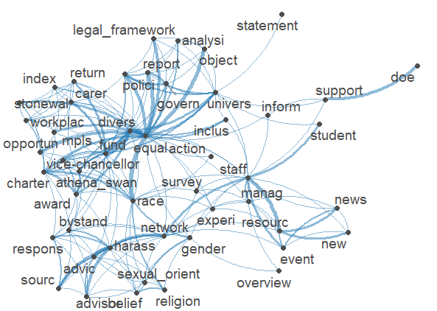
United Kingdom FCM

Slide 19
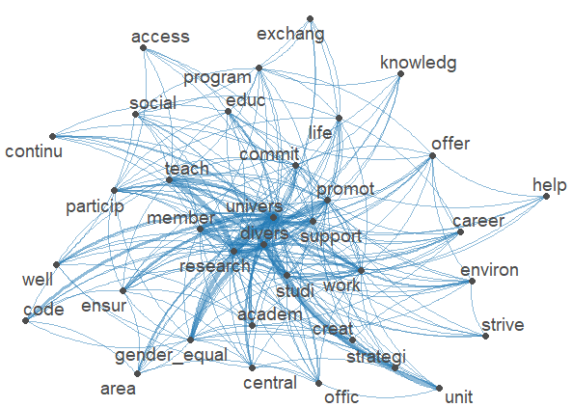
Germany FCM

Slide 20
Where are the Women?
Token | Co-occurrences with “women”
equal | 9
proport | 5
opportun | 2
level | 2
group | 2
increase | 1
various | 1
represent | 1
data | 1

Slide 21
Next Steps
Expand the data set
  Include more universities from each country → how does intra-country diversity discourse differ by institutional ranking?
  PDFs of reports
Try an iterative automated and manual approach to scraping and analysis
  Use HTML code to expand corpus of URLs to scrape
  Complement existing computational analyses with qualitative hand-coding

Slide 22
Challenges
Webscraping: diverging search results (e.g., irrelevant articles), long waiting time, sensitivity of keywords, RSelenium
Text preprocessing: balance between reducing text but still capturing all text of interest, consistency across sources, time consuming
Topic modeling: interpretation of topics
Relied on English translations of German websites → use other language settings/translate data

Slide 23
Thank you for your attention!
(Most) code is on GitHub

